Slide 1
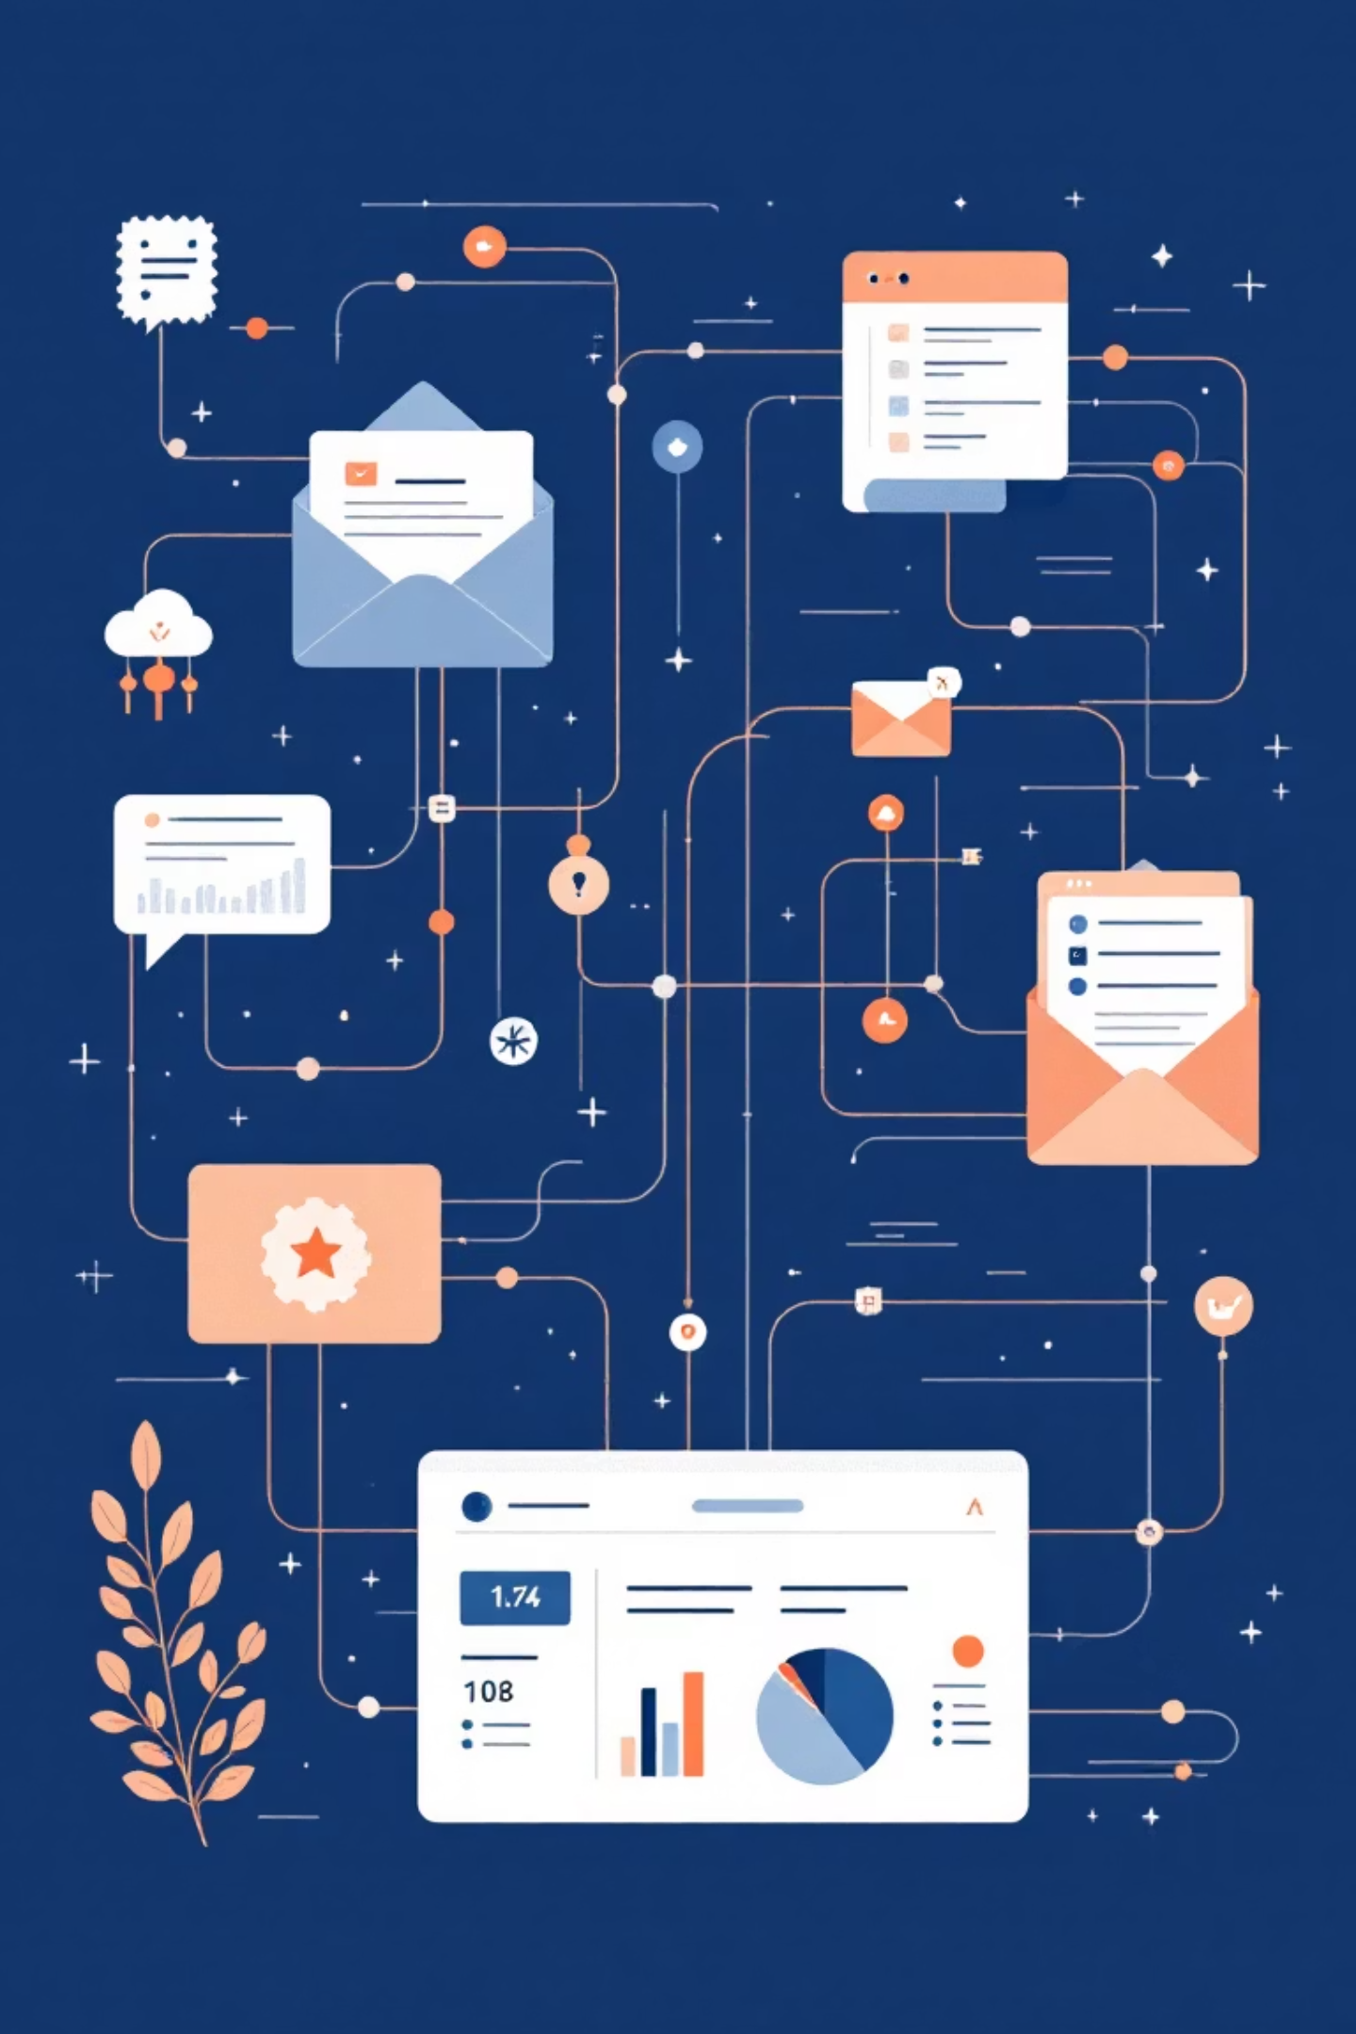

Cold Email Marketing Automation
Automating Outreach to Diamond Retailers using Python, BeautifulSoup & n8n
Presented By: Anshika Sinha – 22108A0045 & Aanchal Choudhary – 22108A0014

Slide 2



Streamlining End-to-End Outreach
Modern diamond retail requires precision and scale. This automation workflow transforms how businesses connect with potential partners by eliminating manual processes while maintaining personalized communication.
Python & BeautifulSoup
Intelligent data extraction
n8n Automation
By integrating Python-based data collection, intelligent email generation, and n8n workflow orchestration, retailers can reach more prospects with less effort—all while tracking performance in real time.
Seamless orchestration
Google Sheets
Real-time tracking

Slide 3

Data Scraping — Building Your Lead Database
Quality outreach begins with quality data. Python scripts powered by BeautifulSoup systematically collect retailer information from trusted industry sources, creating an accurate and continuously updated lead database.
This automated approach ensures you're always working with current contact details, business classifications, and market positioning—eliminating hours of manual research while reducing errors that plague traditional prospecting methods.

Slide 4
01
02
Source Identification
Automated Extraction
Target reliable directories and industry listings containing verified diamond retailer information
BeautifulSoup parses HTML structure to extract names, locations, contact details, and business categories
03
04
Data Validation
Database Population
Scripts verify email formats, remove duplicates, and flag incomplete records for review
Cleaned data flows directly into Google Sheets, ready for personalization and outreach

Slide 5
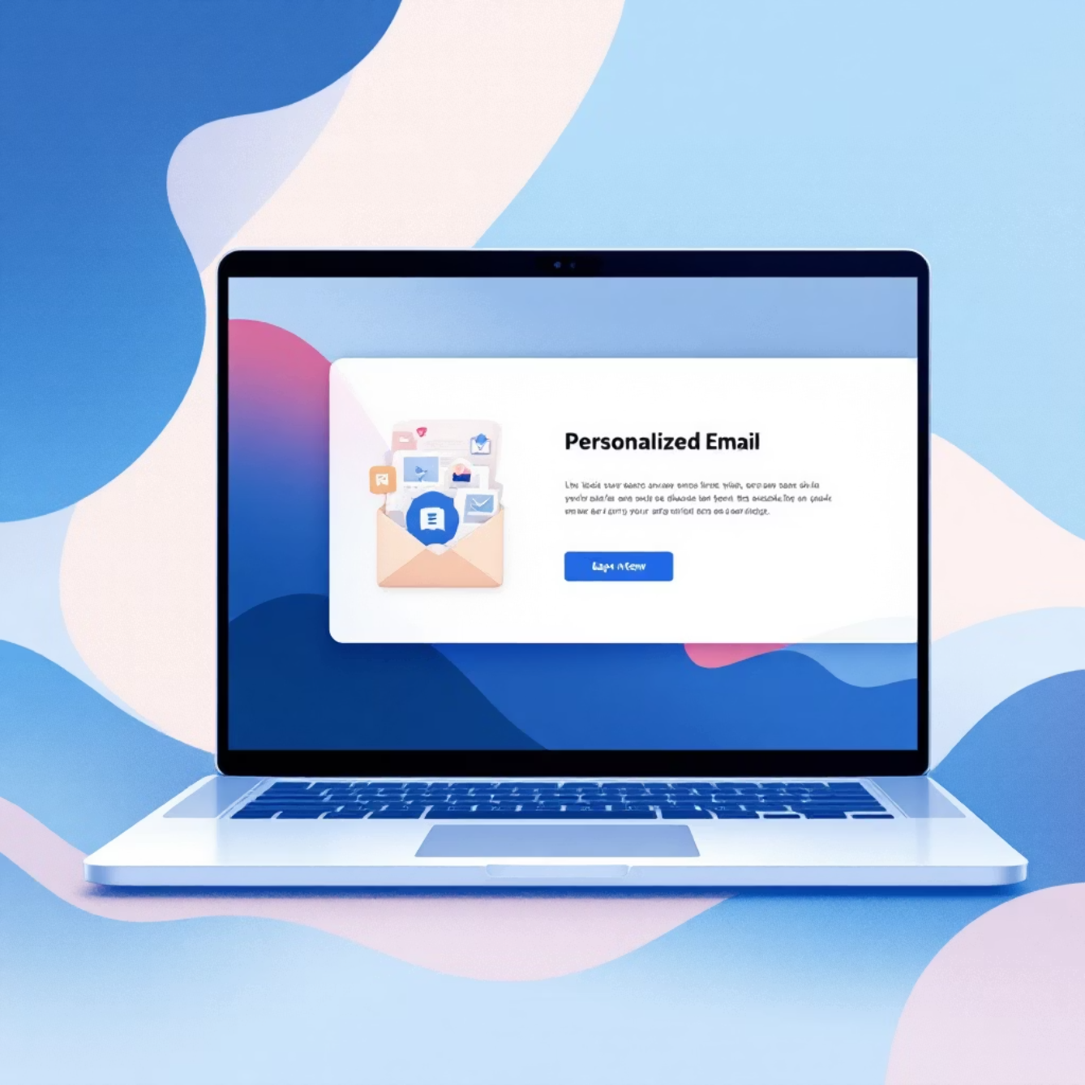
Personalized Emailing — Authentic Engagement at Scale
Generic emails get ignored. Python-generated templates dynamically insert retailer-specific details—company name, location, product focus—creating messages that feel individually crafted rather than mass-produced.
The system can adjust tone, offer specificity, and call-to-action based on retailer size, market segment, or previous engagement history. This intelligent personalization drives response rates significantly higher than traditional blast campaigns.
3x
90%
100%
Response Rate Increase
Time Savings
Consistency
Compared to generic outreach
On email composition
Brand voice maintained

Slide 6

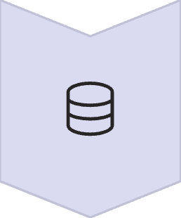



Workflow Automation — The n8n Advantage
n8n serves as the central nervous system, connecting data sources to email platforms while managing timing, triggers, and logging. Visual workflow design makes complex automation accessible—no DevOps team required.
Data Trigger
New leads automatically activate workflow
Processing Logic
Conditional routing based on lead attributes
Email Dispatch
Scheduled delivery at optimal times
Log Updates
Real-time status tracking in Sheets

Slide 7

Real-Time Integration Architecture
Scheduled Execution
Error Handling
Scalable Design
Workflows run on configurable schedules—daily scrapes, weekly sends, hourly status checks—ensuring your outreach never sleeps while you do.
Built-in retry logic and notification alerts catch issues before they impact campaigns, with detailed logging for troubleshooting.
Start with dozens of contacts, scale to thousands. The architecture handles growing volumes without performance degradation.

Slide 8
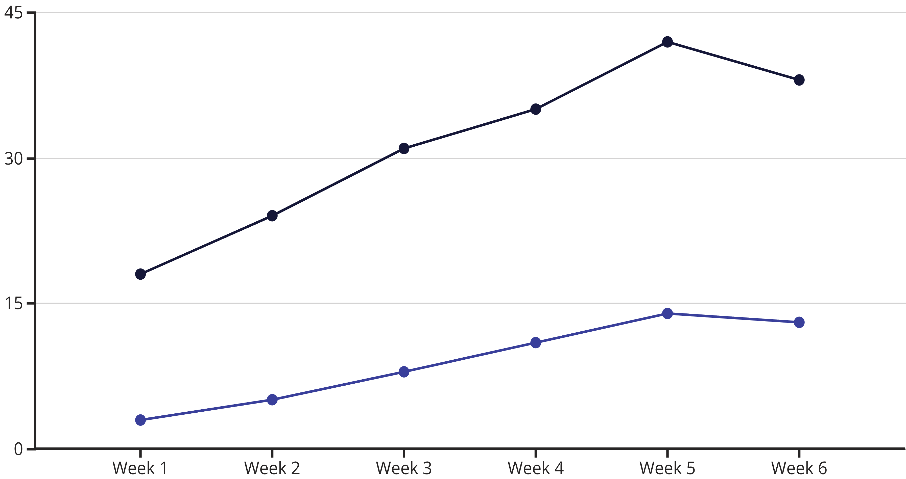
Performance Tracking — Data-Driven Optimization
Every email sent generates insights. Open rates, click-throughs, and response timing flow back into Google Sheets,
creating a feedback loop that continuously improves campaign effectiveness.
Open Rate
Response Rate
Analytics reveal which message templates resonate, which send times perform best, and which retailer segments show highest engagement—allowing strategic refinement of every campaign element.

Slide 9

Measurable Business Impact
15 Hours Saved Weekly
Manual prospecting, email composition, and follow-up tracking eliminated through intelligent automation
300% Increase in Reach
Same team size now contacts three times more qualified retailers with consistent messaging quality
40% Higher Response Rate
Personalization and timing optimization drive engagement that generic campaigns cannot match
Zero Missed Follow-Ups
Automated sequencing ensures every prospect receives timely follow-up without manual calendar management

Slide 10
Automating Smart Outreach Through Intelligent Workflows
The future of B2B outreach isn't about working harder—it's about working smarter. This automation stack combines the precision of Python, the orchestration power of n8n, and the accessibility of Google Sheets to create a system that scales your reach while maintaining authentic, personalized communication.
Data Collection
Orchestration
Automated scraping builds accurate lead database
n8n manages timing and integrations
1
2
3
4
Personalization
Optimization
Dynamic templates create authentic messages
Performance data refines every campaign
Start automating your outreach today and transform how your team connects with diamond retailers worldwide.

